Slide 1
Interstitial delirium: To biopsy or not to biopsy
Youssef HADDAD, M.D
Head of Pulmonary and Critical Care, Lebanese Hospital Geitawi
Head Critical Care Division-Lebanese University

Slide 2
Case presentation
A 32 y.o male, smoker 1 pack per day, obese BMI 32 seen for the first time in August 2019.
He was diagnosed 3 months ago with Hypersensitivity Pneumonitis and put on Prednisone 50 mg/d, Bactrim , Salmeterol/Fluticasone and Atrovent PRN.
PFTs : FVC and FEV1 60% predicted, TLC normal with DLCO 41%
CT Scan

Slide 3
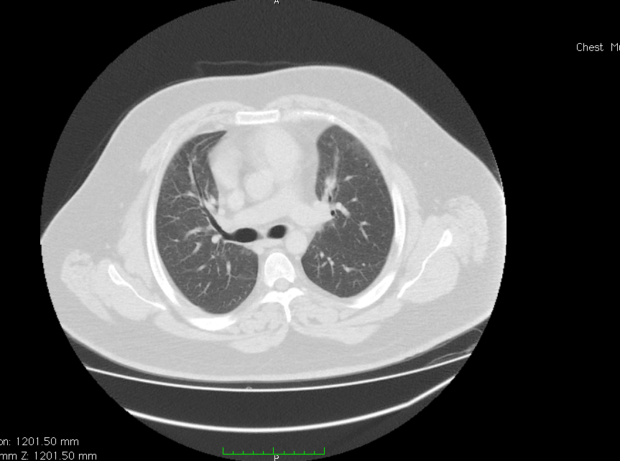
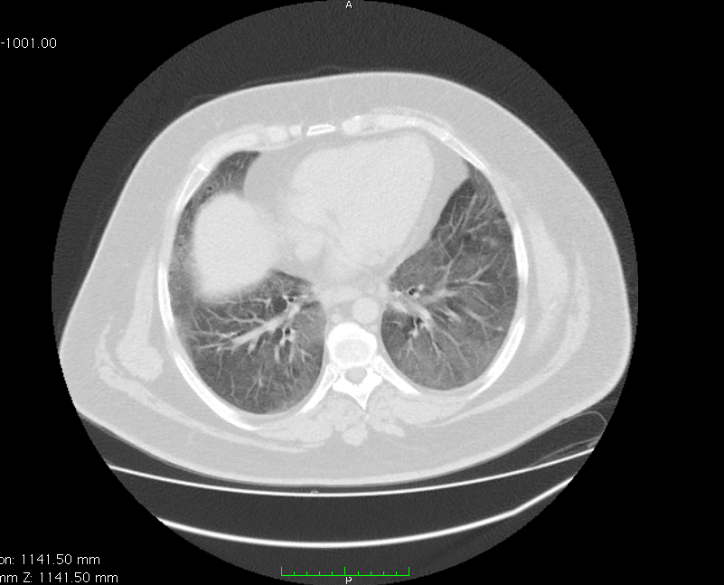
Chest CT

Slide 4
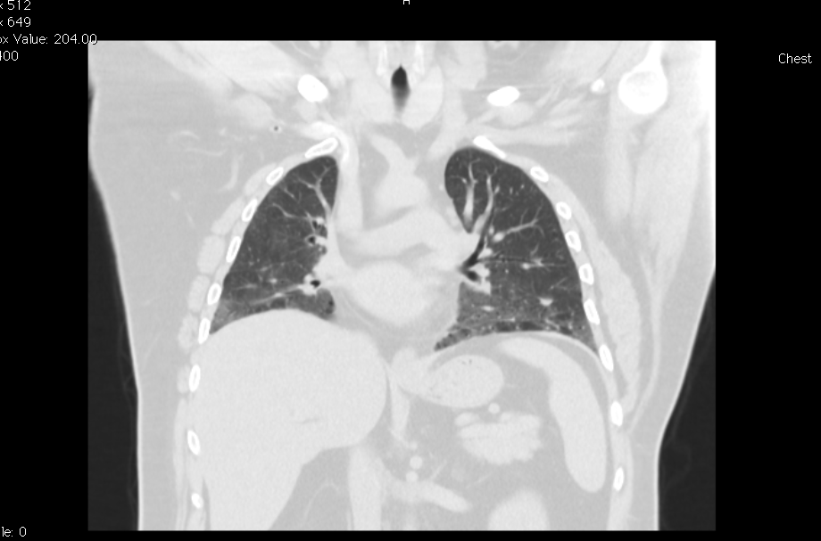
Chest CT

Slide 5
Q1. What to do next?
Increase steroids to 1 mg/kg
Taper down steroids and work up for other diagnosis
Lung biopsy
Add another immunosuppressive medication to steroids.

Slide 6
Case continued
Auto Immune Workup came back negative
Taper down steroids and do bronchoscopy with BAL.
Bronchoscopy studies and cultures came back negative, BAL 20% lymphocytes.
A lung biopsy was done.

Slide 7
Q2. What is the most probable diagnosis?
1. Hypersensitivity pneumonitis
2. Non specific interstitial pneumonia
3. Desquamative interstitial pneumonia
4. Usual interstitial pneumonia
5. Pneumocystis Jirovecii infection

Slide 8
Lung Biopsy Results
Open lung biopsy came back in favor of NSIP.
So increased steroids to 1 mg/kg with advice to stop smoking and diet.
Follow up 3 months later = no improvement in CT Scan or in PFTs DLCO 40%.

Slide 9
Q3. What should we do next?
1. Add another immunosuppressor
2. Give bolus Methylprednisolone
3. Keep same treatment
4. Question the diagnosis

Slide 10
Non specific interstitial pneumonia
This is an interstitial lung disease that is associated with connective tissue disease or could be idiopathic.
The disease has a female predominance and mid adulthood age.
High-resolution computed tomography abnormalities include predominantly lower lobe sub pleural reticular changes, traction bronchiectasis and ground-glass opacities; honeycombing is rarely seen.
Prognosis is overall favorable in comparison with IPF although there is an approximate 20% mortality rate in 5 years
Respirology (2016) 21, 259–268

Slide 11
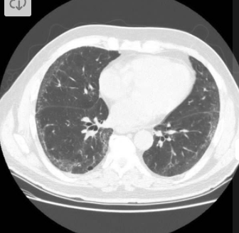
Typical CT Scan

Slide 12
Review steroid resistant NSIP
Systemic steroid therapy (prednisone) at a dose of 0.5 to 1 mg/kg ideal body weight (IBW) up to a maximum dose of 60 mg per day for 1 month, followed thereafter by a dose of 30 to 40 mg per day for an additional 2 months.
For those who respond/stabilize with this treatment, the prednisone should be gradually tapered over 6 to 9 months to a dose of 5 to 10 mg per day or every other day with a goal of potential cessation in therapy after 1 year.
Nayfeh AS, Chippa V, Moore. Nonspecific Interstitial Pneumonitis [2020 Sep 8]

Slide 13
Review steroid resistant NSIP
For patients with severe forms initial therapy with another immunosuppressive agent (azathioprine or cyclophosphamide) could be considered.
Or another suggested algorithm is administration of methylprednisolone bolus for 3 to 5 days.
Refractory disease despite systemic steroid and immunosuppressive agents: Consideration may be given for cyclophosphamide, rituximab, or calcineurin inhibitors.
Respirology (2016) 21, 259–268

Slide 14
Case continued
Admitted for Solumedrol bolus ( 1 gr for 3 days) then discharged on Prednisone 60 mg and Imuran 50 mg BID.
Follow up after 3 months = no clinical deterioration, no change in PFTs and same CT images.
What’s next ?

Slide 15
Q4. How to manage this patient?
1. Change to another immunosuppressor
2. Search for other causes of non improvement ( PE, heart failure …)
3. Question the diagnosis
4. Add bronchodilators

Slide 16
Case continued
Review of the lung biopsy by another pathologist.
A diagnosis of Desquamative Interstitial Pneumonia was raised.

Slide 17
Review of DIP
Desquamative interstitial pneumonia is a rare form of ILD.
It is male predominant and mostly associated with smoking.
DIP is typically characterized by the presence of bilateral ground-glass opacities located in the basal parts of the lung (seen in 92% of patients) and associated with fine reticulation.
In untreated patients, 22% improved over a course of 6.8 years, 15% were stable and 62% worsened.
Desquamative interstitial pneumonia: a systematic review of its features and outcomes. Eur Respir Rev 2020;

Slide 18
Typical CT Scan
Desquamative interstitial pneumonia: a systematic review of its features and outcomes. Eur Respir Rev 2020;

Slide 19
Treatment for DIP
Initial steroid treatment consists of 40‑60 mg/day for 6 weeks, followed by tapering and cessation of the treatment within 6-9 months.
Macrolides are an option in steroid-refractory cases, many cases where no response was obtained after initiation of oral steroids, clinical and radiological improvement was observed at one month after reduction of the steroid dose and addition of clarithromycin.
Data on cytotoxic and immunosuppressive agents for treating DIP are inconclusive. Some positive reports on azathioprine and methotrexate.
DIKEN et al: DESQUAMATIVE INTERSTITIAL PNEUMONIA, 2017

Slide 20
Macrolides in ILD
Effect on autophagy and clearance of cellular protein aggregates.
Another described effect on lipid metabolism and surfactant homeostasis.
Another possible effect on lung microbiota.
Studies on Macrolides and ILD are limited.
A few Case reports were published highlighting the effect of Clarithromycin on DIP cases that were resistant to steroids with rapid and maintained effect.
European Respiratory Review 2017 26: 170082;
Alexey Knyazhitskiy, Chest 2008

Slide 21
Case continued
The patient was kept on Imuran and Steroids tapered to 2.5 mg and clarithromycin was added to his medications.
He finally quit smoking.
Follow up 3 months later
PFTs FVC, FEV1 and FVC improved by 30% , DLCO 60%.
CT Scan

Slide 22
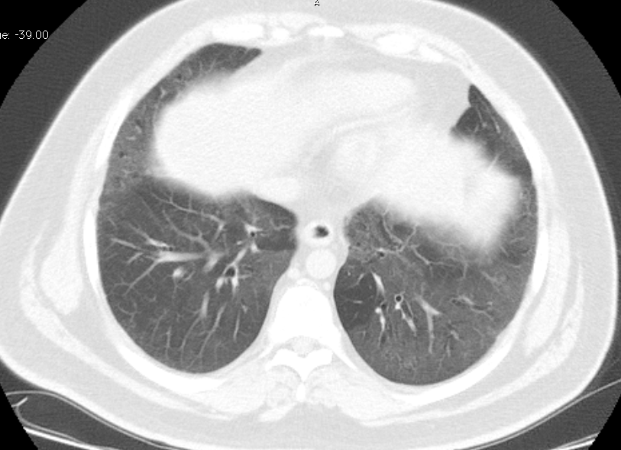
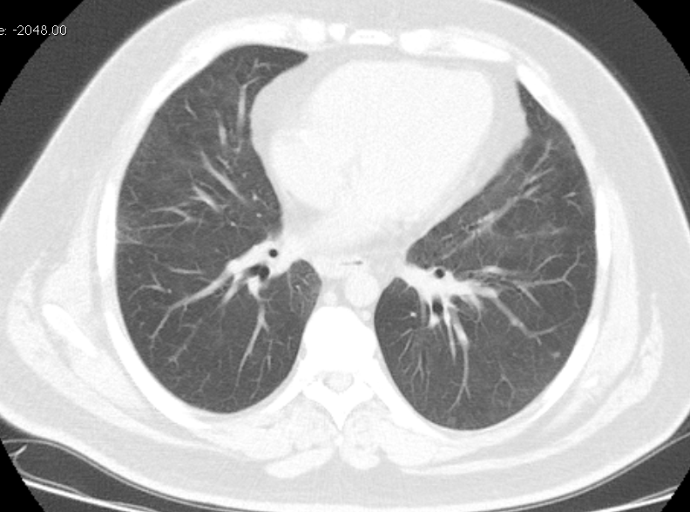
Chest CT follow up

Slide 23
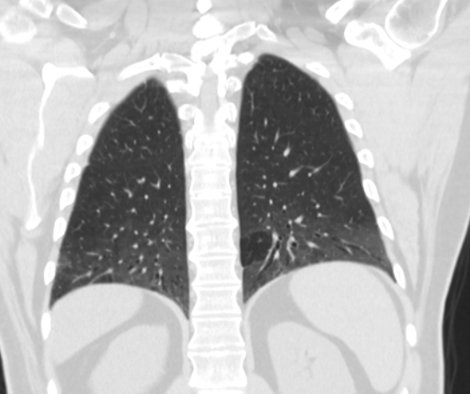
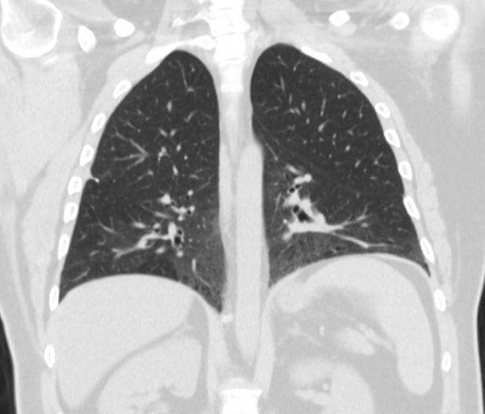
Chest CT follow up

Slide 24
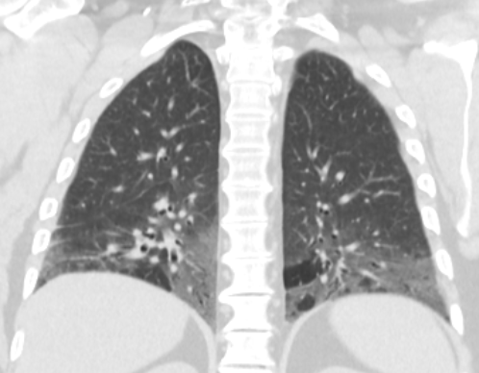
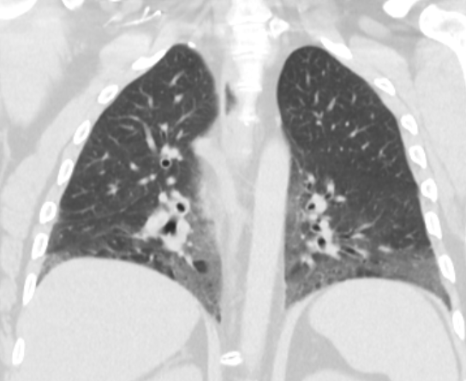
BEFORE
BEFORE
AFTER
AFTER

Slide 25
What you see is not always what is there!

