Slide 1
LUNGS FULL OF MILK
ALFRED DIB, MD
SACRE-COEUR HOSPITAL
APRIL 8th, 2021

Slide 2
CASE PRESENTATION
48YO, MALE
SMOKER, 60PY.
SALESMAN OF FREEZED FOOD PRODUCTS.
LATE AUGUST,2020.
4 WEEKS OF PROGRESSIVE DYSPNEA, THAT BECAME ON MINIMAL EXERCISE.
NON PRODUCTIVE COUGH, AND CHEST DISCOMFORT.
UNINTENTIONAL WEIGHT LOSS 8KG.

Slide 3
PHYSICAL EXAMINATION
HE LOOKS PALE.
TACHYPNEIC, 30/MIN.
SATURATION 89% ON ROOM AIR.
DECREASE AIR ENTRY, WITH BILATERAL CRACKLES.

Slide 4
LABORATORY FINDINGS
Hb 15.4 g/dl
WBC =9280 LYMP=21% NE= 61% EOS=1 %
CRP=6
LDH=205, FERRITIN NLE,
PROCALCITONIN=0.08
PH 7.45 PaO2 63 PCO2 34 HCO3- 22

Slide 5
CHEST-X-RAY

Slide 6
CT SCAN OF CHEST

Slide 7
COVID-19 PANDEMIA IN LEBANON AUGUST2020
2 PCR SARS COV2 WERE NEGATIVE OUTSIDE THE HOSPITAL.
BEFORE HIS PRESENTATION THE PATIENT WAS STARTED ON ANTI CORONA TREATEMENT WITH VITIMINS , HYDROXYCHLOROQUINE AND AZITROMYCIN.
THE REPEATED PCR WAS ALSO NEGATIVE.
THE SEROLOGY IGM IGG WAS NEGATIVE.

Slide 8
WHAT IS THE MOST LIKELY DIAGNOSIS?
1-COVID PNEUMONIA AND/OR POST-COVID LUNG DISEASE.
2-ATYPICAL MULTILOBAR PNEUMONIA.
3-EOSINOPHILIC LUNG DISEASE.
4-DIFFUSE ALVEOLAR HEMMORRHAGE.
5-OTHER DIAGNOSIS.

Slide 9
WHAT DO YOU THINK SHOULD BE THE NEXT STEP?
1- DO BRONCHOSCOPY AND OBTAIN BAL.
2- DO SYSTHEMIC DISEASE WORK-UP.
3- DO 6MWT.
4- DO PFT’S.
5-ALL OF THE ABOVE.

Slide 10
PULMONARY FUNCTION TEST
FVC=3.83L (85%)
FEV1=3.1L (85%)
RATIO=80%
RV=70%
TLC =5.24L (76%)
DLCO= 60%

Slide 11
6 MWT
530 METERS
HR 96/MIN → 136/MIN
SAT 92%→ 88%

Slide 12
SYSTHEMIC DISEASE WORK-UP
NEGATIVE

Slide 13
BRONCHOSCOPY
WAS NORMAL
BAL WAS DONE
WBC 1200/MM3 30%LYMPH 54%NE 0%EOS 15%MACROPHAGE
CULTURE SHOWED A SENSTIVE Streptococcus Mitis.
ZEIHL NELSON AND SILVER STAIN WERE NEGATIVE

Slide 14
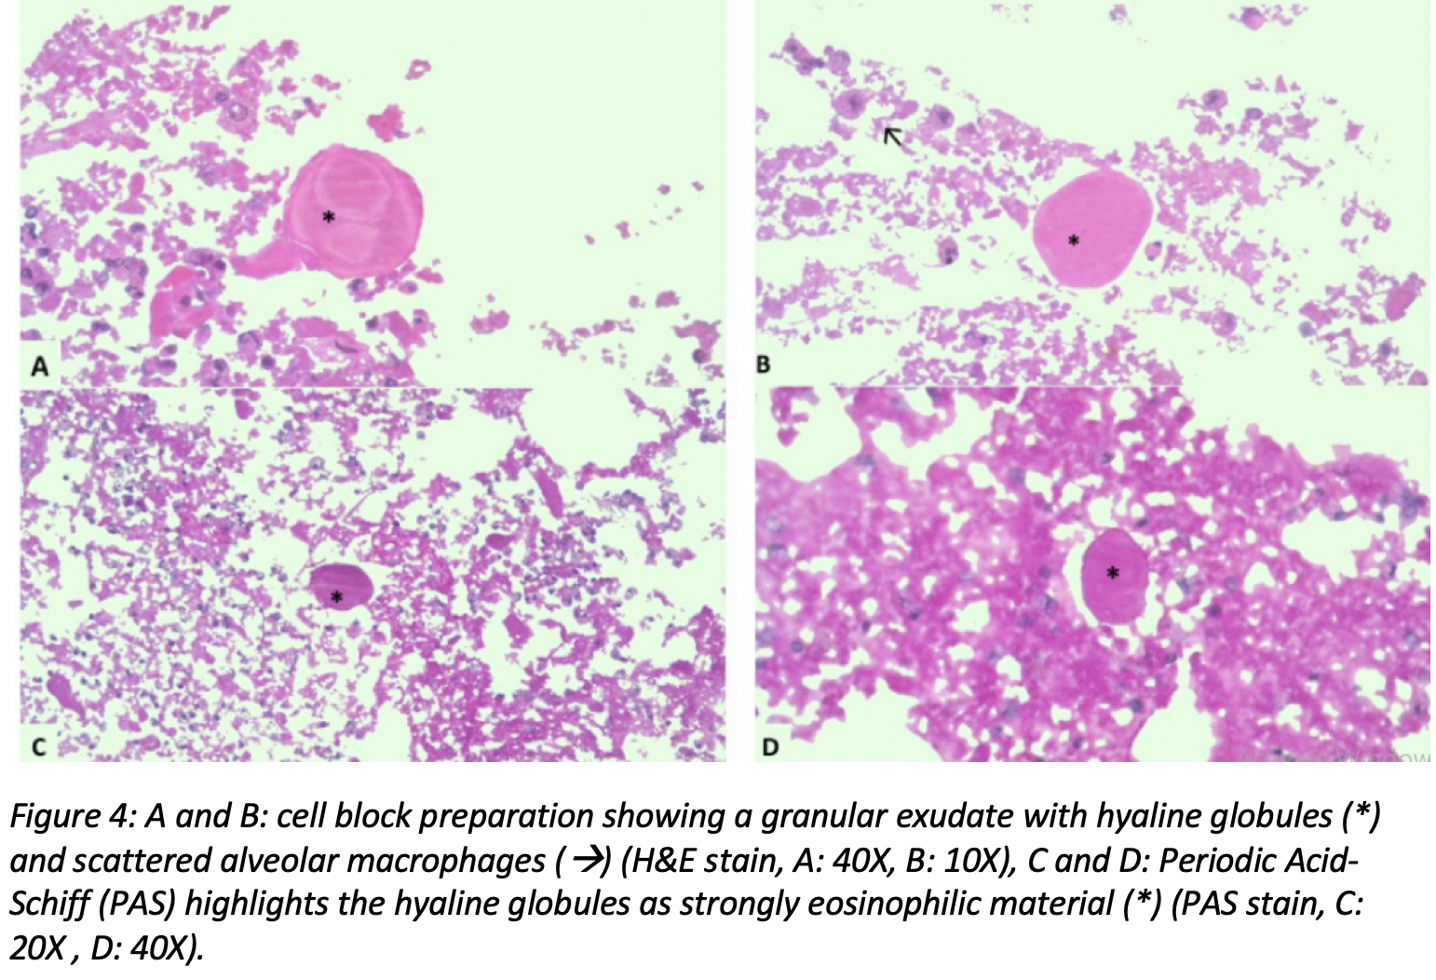
THE KEY DIAGNOSIS
PAS COLORATION

Slide 15
WHAT IS THE DIAGNOSIS
1- PULMONARY ALVEOLAR PROTEINOSIS
2-PULMONARY ALVEOLAR HEMMORRHAGE
3-COVID-19 PNEUMONIA
4-EOSINOPHILIC LUNG DISEASE

Slide 16
PATHOLOGY

Slide 17
PULMONARY ALVEOLAR PROTEINOSIS

Slide 18
THE KEY DIAGNOSIS
Anti GM_CSF Antibodies were positive
CARECTERISE THE AUTOIMMUNE SUBTYPE OF PAP

Slide 19
PAP PULMONARY ALVEOLAR PROTEINOSIS
Rare diffuse pulmonary disease
Rosen et al. in 1958
PAP as a lung disease in which lipid-rich, periodic acid-Schiff (PAS) positive lipoproteinaceous material.
impaired function of alveolar macrophages, thus impairing gas exchange.
Rosen SH, Castleman B, Liebow AA. Pulmonary alveolar proteinosis. N Engl J Med 1958; 258: 1123–42.
R. Borie, C. Danel, M-P. Debray, C. Taille,, M-C. Dombret, M. Aubier,R. Epaude, and B. Crestani, “Pulmonary alveolar proteinosis” European Respiratory Review . 2011; 20: 98-107.

Slide 20
PAP PULMONARY ALVEOLAR PROTEINOSIS
Between the third and fifth decade.
3:1 male to female ratio.
Prevalence 3.7 to 40 cases per million.
incidence of almost 0.2 cases per million per year.
More than half of patients with autoimmune PAP have a smoking history (57% in Japanese cohort, 79% in German cohort, and 64% in Italian cohort).
BN PANDA. “ALVEOLAR PROTEINOSIS (A Case Report)”. MJAFI. 1994; 50: 223-225.Pulmonary alveolar proteinosis management: current and future therapeutic startegies
Yoshikazu Inoue et al. “Characteristic of a large cohort of patients with autoimmune pulmonary alveolar proteinosis in japan”. American Journal of Respiratory and Critical Care Medicine. 2008 April 1; 177(7): 752-762.
Takuji Suzuki, MD, PhD, Bruce C. Trapnell, MD. Pulmonary Alveolar Proteinosis Syndrome. Clin Chest Med. 2016 September ; 37(3): 431–440.

Slide 21
PAP PULMONARY ALVEOLAR PROTEINOSIS
Autoimmune, previously known as idiopathic (90-95%)
Secondary including hematologic malignancies, environmental exposures as inhalation of toxic materials, infectious agents and immunodeficiency (5-10%)
genetic or hereditary (<1%)
Unclassified PAP (<1%)
Kumar.A, Abdelmalak.B, et al, “Pulmonary alveolar presteinoisis in adults: pathophysiology and clinical approach”, Lancet resp Med, vol.6, 2018 January 31.
Campo, I., Luisetti, M., Griese, M. et al. Whole lung lavage therapy for pulmonary alveolar proteinosis: a global survey of current practices and procedures. Orphanet J Rare Dis 11, 115 (2016).

Slide 22
PATHOPHYSIOLOGY (NEJM 2003)

Slide 23
PAP PULMONARY ALVEOLAR PROTEINOSIS

Slide 24
WHAT IS THE BEST TREATMENT FOR PAP?
1- WHOLE LUNG LAVAGE
2- PLASMAPHERESIS
3- RITUXIMAB
4- GM-CSF INHALED OR SUBCUTANOEUS.

Slide 25
TREATMENT MODALITY
WHOLE LUNG LAVAGE (WLL)
washing one lung with normal saline for several cycles
GA, and is followed by mechanical ventilation of both lungs for few hours with monitoring in the ICU
WLL is also indicated in cases of worsening disease.

Slide 26
CORNERSTONE TREATMENT GM-CSF / SUBCUTANEOUS INJECTION

Slide 27
CORNERSTONE TREATMENT GM-CSF / INHALED MOLGRAMOSTIM

Slide 28
TREATMENT MODALITY
PLASMAPHERESIS
RITUXIMAB
CLEARANCE OF ANTI GM-CSF ANTIBODIES

Slide 29
3 MONTHS OF TREATMENT WITH SC GM-CSF

Slide 30
3 MONTHS OF TREATMENT WITH SC GM-CSF
FVC=3.83L (85%)
FEV1=3.1L (85%)
RATIO=80%
RV=70%
TLC =5.24L (76%)
DLCO= 60%
BEFORE
FVC=3.77L (84%)
FEV1=2.92L (80%)
RATIO=77%
RV=80%
TLC =5.43L (79%)
DLCO= 73%
AFTER

Slide 31
6 MWT
530 METERS
HR 96/MIN → 136/MIN
SAT 92%→ 88%
CHEST DISCOMFORT, DYSPNEA
BEFORE
630 METERS
HR 96/MIN → 120/MIN
SAT 97%→ 96%
ASSYMPTOMATIC
AFTER

Slide 32
THANK YOU
LPS
ASTRAZENECA

